Slide 1


SQS – the world’s leading specialist in software quality
sqs.com
Introduction to ISO8583 messaging
Jan 2016

Slide 2
Agenda
20th January
Introduction to cards and high level authorization message flow architecture
Types of messages, and related functionality
ISO 8583 standard and scheme specific derivatives
21st January
Basic introduction to EMV
DES cryptography and data dependencies
PIN based transaction and PIN translation
22nd January
Understanding data integrity in messages and troubleshooting rejects
Common ISO response codes
FaXimme Demo – To understand message injection and structure
Evaluation

Slide 3
Session 1
20th January
Introduction to cards and high level authorization message flow architecture
Types of messages, and related functionality
ISO 8583 standard and scheme specific derivatives

Slide 4
High Level Cards’ Functions
CARDS
Credit Decision and Account Origination
Offers Management
Embossing
Card Delivery and Activation
Financial Authorization processing
Fraud Management
Loyalty Management
Clearing and Settlement – Transaction management
Statements
Payment Processing
Default handling and Collections
Letters and Mailers
Fees Processing – Account, Card and Transaction level
Dispute handling and Chargebacks
Customer Services
Web services API
MERCHANTS

Slide 5
Terminology
Authorization – Promise to Pay
Clearing – Request to Pay
Settlement – Realize Payment
Card Holder
Issuer/ Issuing Bank
Card Plastic
Acquirer/Acquiring Bank
Merchant
POS Terminal
Ecommerce
Gateway
Channels
DES – Data Encryption Standard Algorithm
HSM – Host Security Module
Key Management System
DES Keys - PIN Encryption Keys, PIN Validation Keys, Chip Keys, CVV keys etc.
Switch - Base24, Postilion
Card Schemes – Domestic
Card Schemes – International
Parsing and Formatting

Slide 6
Key Entities In Authorization Processing
Cardholders - Persons who are authorized to use credit cards for the payment of goods and services
Merchants - Firms which agree to accept credit cards for payment of goods and services
Acquirers - Institutions which enter into agreements with merchants to process their credit card transactions
Credit Card Associations/ Schemes - Organizations that license card issuers to issue credit cards under their trademark, e.g. Visa and MasterCard, and provide settlement services for their members (card issuers and merchant acquirers)
Issuers – Institution/ Bank that has issued the credit / debit card
Regulatory Agencies – Country Specific (e.g., BBA, CCA for UK)

Slide 7
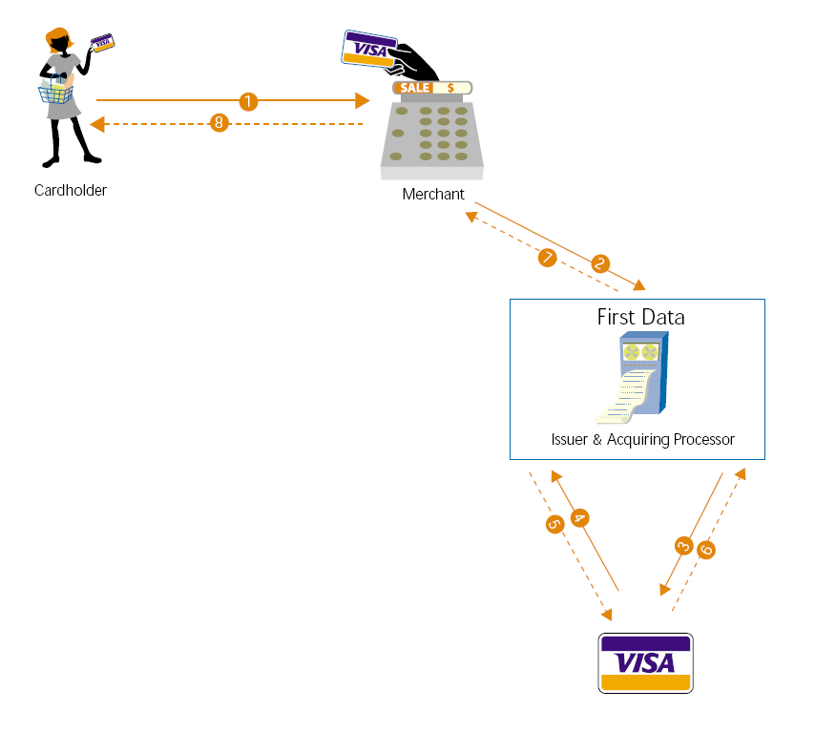
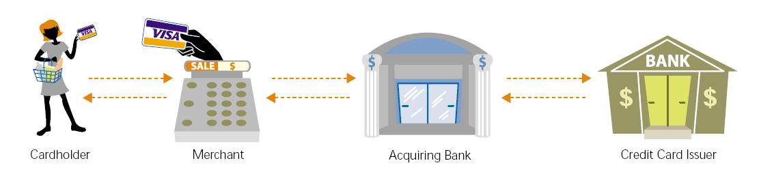
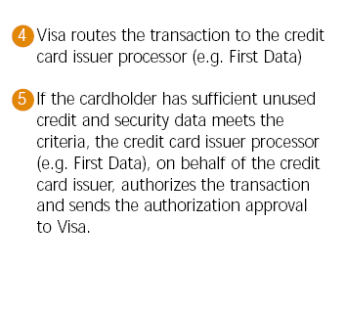
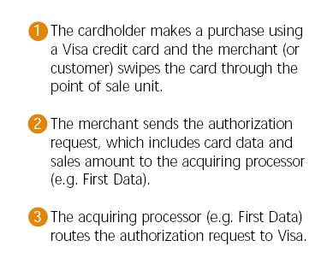
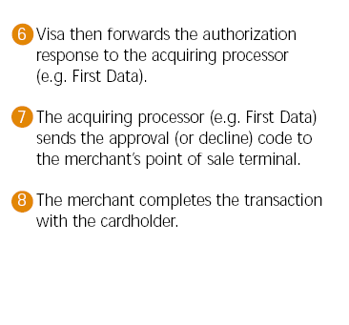
Authorization Message Flow

Slide 8
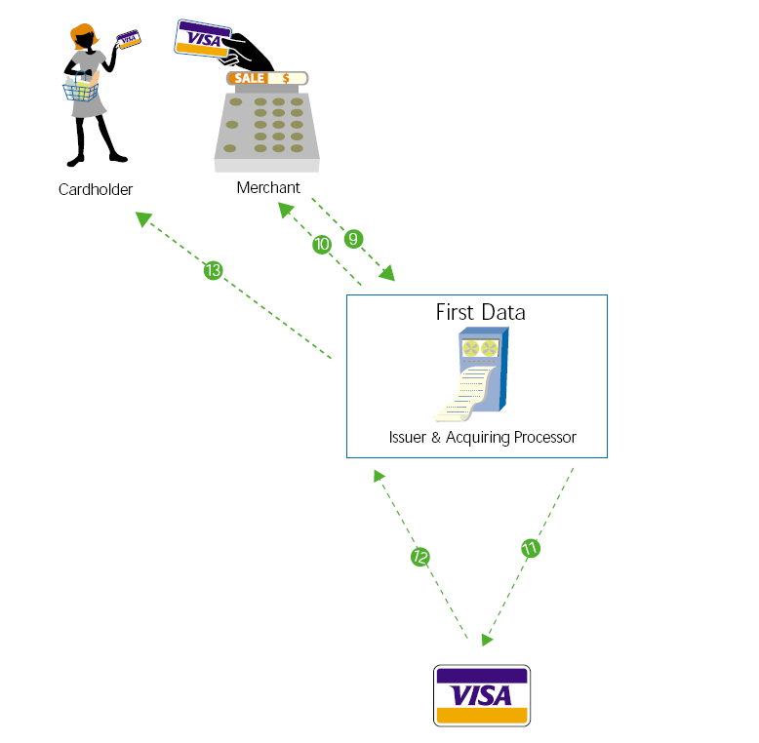
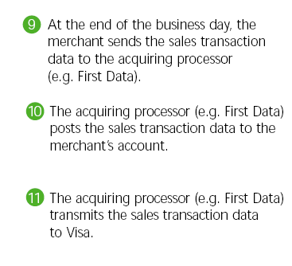
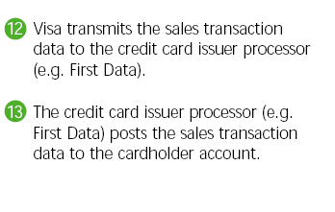

Clearing Flow

Slide 9
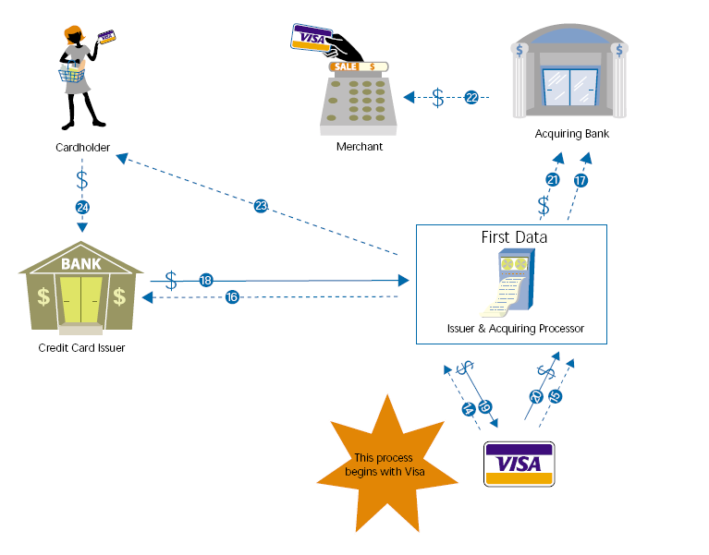
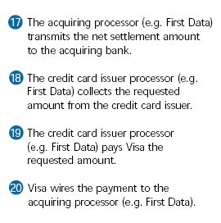
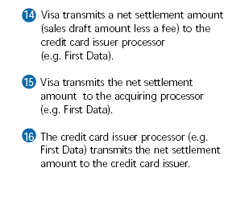
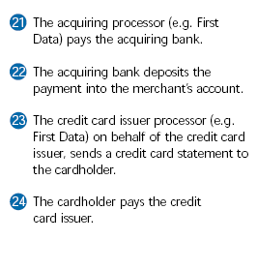
Settlement Flow

Slide 10
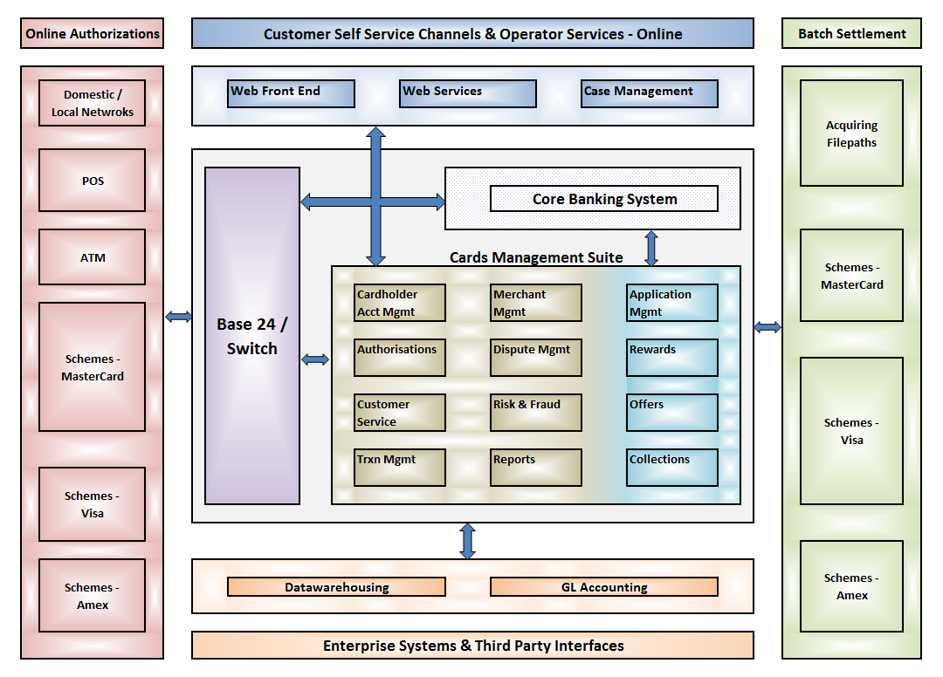
Typical Cards Architecture

Slide 11
Typical Cards Architecture

Slide 12
Types of Cards
Requirements Based Business Assurance
Charge Cards
Credit Cards
Debit Cards
Prepaid Cards
Consumer Cards
Commercial Cards
Scheme branded
Cobranded Cards
Affinity Cards
Private Label
ATM Cards
PIN Debit
Decoupled Debit
Open Loop
Closed Loop

Slide 13
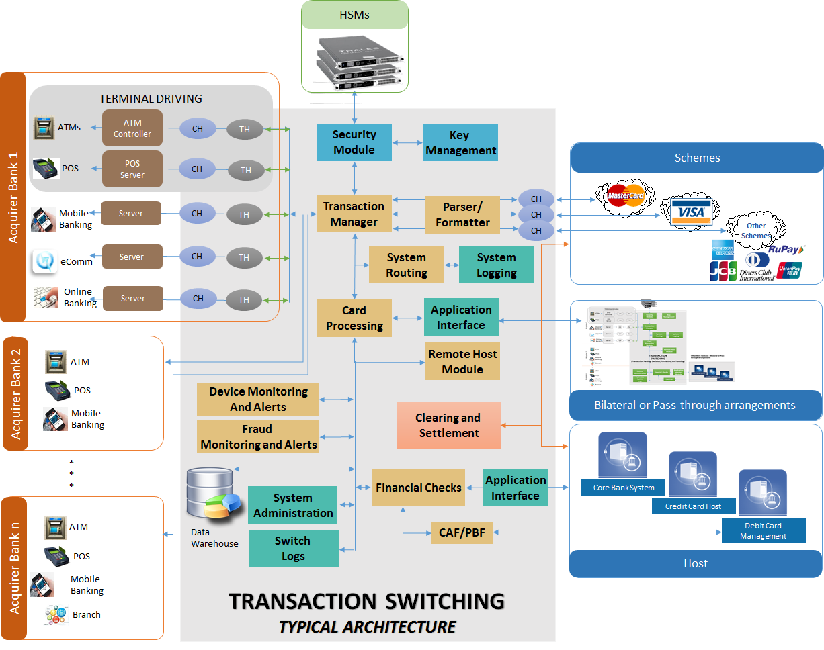
Message Flow Architecture

Slide 14
Key Players
Issuers
Schemes & Links
Banks
Financial Service Provides
Amex
MasterCard
VISA
CUP
Diners
JCB
RuPay
Domestic Networks
Acquirers
ATM & POS Terminals
NCR
Diebold
Wincor
Verifone
Gemalto
Spectra
Zeta
PAX
Hypercom
Banks
Financial Service Provides
Switches
Rewards
Application Providers
Base24
ITM
Airmiles
Payback
eFunds’ Connex
Postilion
PlanetPayment
VisionPLUS
HPS PowerCard
OmniPay
Tieto Card Suite
TS2
PRIME
Risk & Fraud Applications
eCommerce Fraud Mgmt
Credit Bureaus
PROBE
Falcon
TRIAD
FRAUDGUARD
CyberSource
Acculink
Ascertify
Experian
Trans Union
Equifax
Processing Service Providers
First Data
TSYS
ATOS
FIS
CSC
Fiserv
Visa
MasterCard

Slide 15
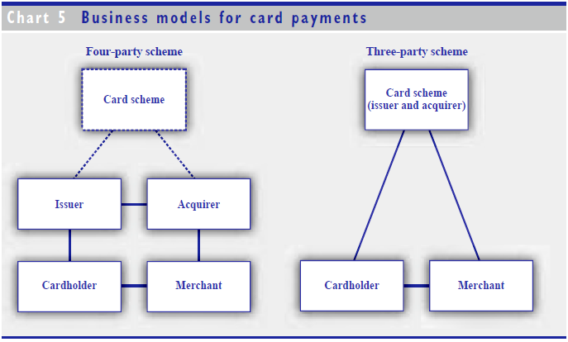
Business Models for Credit Cards
In three-party schemes, the scheme itself is responsible for the issuing of cards and the acquisition of transactions
A four-party scheme, by contrast, relies on separate actors, normally banks,
for issuing and acquiring

Slide 16
Transaction Types
POS Transactions
Sale
Sale with Tip
Instalment Sale
Redemption/Points Sale
Refund
Void – Sale, Refund
Tip Adjustment
Pre-Authorisation
Sale Completion (Offline)
Offline Sale
Offline Refund
Batch Upload
Reversals
ATM Transactions
With Drawls
Balance Inquiry
Mini Statement
Cash deposit
Check deposit
Funds Transfer
Check book request
PIN select
PIN Change

Slide 17
Transaction Types
A Sale transaction credits the merchant and debits the cardholder. It is used when a cardholder purchases goods and/or services from a merchant.
A Refund transaction debits the merchant and credits the cardholder. It is used when a merchant accepts a return of goods previously sold (via a sale transaction) to the cardholder
A Void cancels a Sale transaction or a Refund and is only available for transactions that are within an Open batch (see Terminal Batches section below). A void is often referred to as a “same day refund”. The net effect of a voided transaction is to reduce the original transaction amount to zero

Slide 18
Transaction Types
Tip Adjustment increases the amount of a Sale transaction and debits the cardholder and credits the merchant and is only available for transactions that are within an Open batch. It is common practice for the acquirer to accumulate the original sale transaction and tip together as a single transaction when billing the cardholder. It also common practice to limit the tip to a percentage of the original amount (usually 15%). Tip transactions are limited to Hospitality type merchants.
Pre-authorisation seeks an authorisation of funds only and is not a value based transaction. As a result of an approved pre-authorisation an issuer may place the requested funds “on hold” for a specified period of time. These transactions are usually limited to Hospitality type merchants

Slide 19
Transaction Types
Sale Completion is an offline (not online authorised) value based transaction that credits the merchant and debits the cardholder. It is assumed that the merchant has sought prior authorisation (manual or via the terminal) prior to entering the Offline Sale. A Sales Completion is used as a follow-up transaction to a Pre-authorisation. These transactions are usually limited to Hospitality type merchants
Offline Sale is an offline (not online authorised) value based transaction that credits the merchants and debits the cardholder. Alternate authorisation (i.e. manual) is sought and the authorisation code entered when the offline transaction is keyed into the terminal. This transaction is similar to the Sale Completion transaction

Slide 20
Transaction Types
Settlement is a transaction initiated at the terminal by the merchant, the settlement transaction closes the current terminal batch and opens a new batch. A Settlement receipt is printed at the terminal showing the terminal totals for the settled batch
Batch Upload can occur for two reasons
for ISO8583 based terminals Batch Upload is a process that replays all transactions in a batch to the host (when a Settlement is attempted) and the terminal and host terminal totals do not match.
For MDC based terminals Batch Upload occurs whenever a terminal settlement occurs, in this case it is the Batch Upload that is used to create the merchant funding value rather than the APACS authorisation transactions

Slide 21
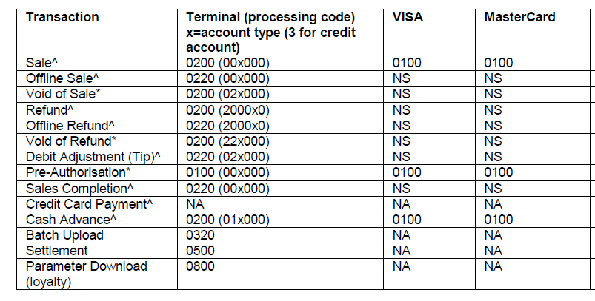
Message Types
NS = Sent online (0200 only) by terminal but not forwarded to Issuer / Card Scheme online only via a clearing record, Logged only and accumulated at EOD 80-byte for value.
NA = Not Applicable
*Not for value transaction (Voids will reduce original transaction value to zero) Online Void requests sent by terminal if the transaction being voided was already sent to host, otherwise original transaction voided in batch and not sent to host.
^All approved transactions will be accumulated at EOD into 80-byte file for value

Slide 22
Authorization System Features
Scheme connectivity
Voice Authorizations
On Us – Off Us Authorization
EMV / Chip card Authorizations
Special Transactions –
Installment
Loyalty
Velocity Checks
Status/ Block Code Checks
Overlimit Auths
Special Account Handling
Authorization Logs
Decline Codes – Mapping to Scheme/ Network Decline Codes
Monitoring Referrals
Interface with
Risk & Fraud applications
Auth Scoring services
After hours Authorizations
Authorization Matching &Dropping Outstanding Authorizations
Reports

Slide 23
Message schema for financial messaging
Authorization formats - Common bitmapped, tagged and fixed field length message formats
ISO8583 – 1987, 1993 and 2003 versions
Amex CAS
Amex GNS
FIS ISO (formerly eFunds ISO)
LIS5 ISO
MasterCard Credit
MasterCard Debit
ISO20022
SPDH – Standard POS Device Handler specifications
AS2805 – Australian standard
ATM Formats – NDC, NDC+, DDC etc.
POS Formats - APACS 30, EIS1080
Outdated Standards - PC501, PC107A
Discover ISO
NYCE ISO
Pulse
Shazam ISO
TSYS ISO 8583
DCI Express
Visa DPS
Visa SMS ATM
Visa SMS Interlink

Slide 24
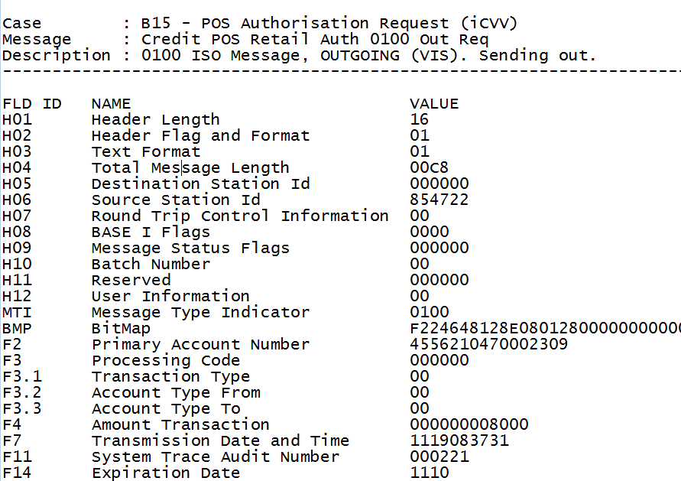
ISO 8583 Message Structure
1
To identify source, destination, message length, reject reason etc.
Header
2
MTI
Bitmap
3
Data Elements
4

Slide 25
ISO 8583 interpretation
0xxx -> version of ISO 8583
x1xx -> class of the Message
xx1x -> function of the Message
xxx0 -> who began the communication
Position 1 - ISO 8583 version
Position one of the MTI specifies the versions of the ISO 8583 standard which is being used to transmit the message.
Position | Meaning
0xxx | ISO 8583-1:1987 version
1xxx | ISO 8583-2:1993 version
2xxx | ISO 8583-1:2003 version
9xxx | Private usage

Slide 26
ISO 8583 interpretation (contd..)
Position 2 - Message class
Position two of the MTI specifies the overall purpose of the message.
Position | Meaning
x1xx | Authorization Message
x2xx | Financial Message
x3xx | File Actions Message
x4xx | Reversal Message
x5xx | Reconciliation Message
x6xx | Administrative Message
x7xx | Fee Collection Messages
x8xx | Network Management Message
x9xx | Reserved by ISO

Slide 27
ISO 8583 interpretation (contd..)
Position 3 - Message function
Position | Meaning
xx0x | Request
xx1x | Request Response
xx2x | Advice
xx3x | Advice Response
xx4x | Notification
xx8x | Response acknowledgment
xx9x | Negative acknowledgment

Slide 28
ISO 8583 interpretation (contd..)
Position 4 - Message origin
Position four of the MTI defines the location of the message source
within the payment chain.
Position | Meaning
xxx0 | Acquirer
xxx1 | Acquirer Repeat
xxx2 | Issuer
xxx3 | Issuer Repeat
xxx4 | Other
xxx5 | Other Repeat

Slide 29
ISO 8583 MTI examples
MTI | Meaning | Usage
0100 | Authorization request | Request from a point-of-sale terminal for authorization for a cardholder purchase
0110 | Issuer Response | Issuer response to a point-of-sale terminal for authorization for a cardholder purchase
0120 | Authorization Advice | When the Point of Sale device breaks down and you have to sign a voucher
0121 | Authorisation Advice Repeat | if the advice times out
0130 | Issuer Response to Authorization Advice | Confirmation of receipt of authorization advice
0200 | Acquirer Financial Request | Request for funds, typically from an ATM or pinned point-of-sale device
0210 | Issuer Response to Financial Request | Issuer response to request for funds
0220 | Acquirer Financial Advice | e.g. Checkout at a hotel. Used to complete transaction initiated with authorization request

Slide 30
ISO 8583 MTI examples
0221 | Acquirer Financial Advice repeat | if the advice times out
0230 | Issuer Response to Financial Advice | Confirmation of receipt of financial advice
0400 | Acquirer Reversal Request | Reverses a transaction
0420 | Acquirer Reversal Advice | Advises that a reversal has taken place
0421 | Acquirer Reversal Advice Repeat Message | if the reversal times out
0430 | Issuer Reversal Response | Confirmation of receipt of reversal advice
0800 | Network Management Request | Echo test, logon, log off etc.
0810 | Network Management Response | Echo test, logon, log off etc.
0820 | Network Management Advice | Key change

Slide 31
Bitmaps
Primary Bitmap indicates which of Data Elements 1 to 64 are present
Secondary Bitmap indicates which of Data Elements 65 to 128 are present
Tertiary Bitmap indicates which of Data Elements 129 to 192 are present
Data type: 8 bytes of binary data, or as 16 hexadecimal characters 0-9, A-F in the ASCII or EBCDIC character sets.
Primary Bitmap | Defines presence of
4210001102C04804 | Fields 2, 7, 12, 28, 32, 39, 41, 42, 50, 53, 62
Explanation of Bitmap (8 BYTE Primary Bitmap = 64 Bit) field 4210001102C04804 BYTE1 : 01000010 = 42x (indicating that fields 2 and 7 are present) BYTE2 : 00010000 = 10x (field 12 is present) BYTE3 : 00000000 = 00x (no fields present) BYTE4 : 00010001 = 11x (fields 28 and 32 are present) BYTE5 : 00000010 = 02x (field 39 is present) BYTE6 : 11000000 = C0x (fields 41 and 42 are present) BYTE7 : 01001000 = 48x (fields 50 and 53 are present) BYTE8 : 00000100 = 04x (field 62 is present)

Slide 32
Hexadecimal and Binary
Hex | Binary | Numeric
0 | 0000 | 0
1 | 0001 | 1
2 | 0010 | 2
3 | 0011 | 3
4 | 0100 | 4
5 | 0101 | 5
6 | 0110 | 6
7 | 0111 | 7
8 | 1000 | 8
9 | 1001 | 9
A | 1010 | 10
B | 1011 | 11
C | 1100 | 12
D | 1101 | 13
E | 1110 | 14
F | 1111 | 15
Example #1
Convert (4E)₁₆ to binary:
(4)₁₆ = (0100)₂
(E)₁₆ = (1110)₂
SO, (4E)₁₆ = (01001110)₂
Example #2
Convert (4A01)₁₆ to binary:
(4)₁₆ = (0100)₂
(A)₁₆ = (1010)₂
(0)₁₆ = (0000)₂
(1)₁₆ = (0001)₂
SO, (4A01)₁₆ = (0100101000000001)₂

Slide 33
Hexadecimal and Binary
Write your binary number down as below
10110010
Now, divide that number into groups of four numbers:
1011 0010
Now, with each of these groups, write numbers underneath the letters, from RIGHT TO LEFT. These numbers start with one, and double each time, i.e. 1 2 4 8. Now you should have:
1011 0010
8421 8421
Now, for each digit, multiply the top digit by the bottom digit, and write it underneath, like this:
1011 0010
8421 8421
8021 0020
Now, on the bottom line, for each group of four numbers, add them up:
8021 0020
8 + 0 + 2 + 1 = 11
0 + 0 + 2 + 0 = 2
11 2
B2

Slide 34
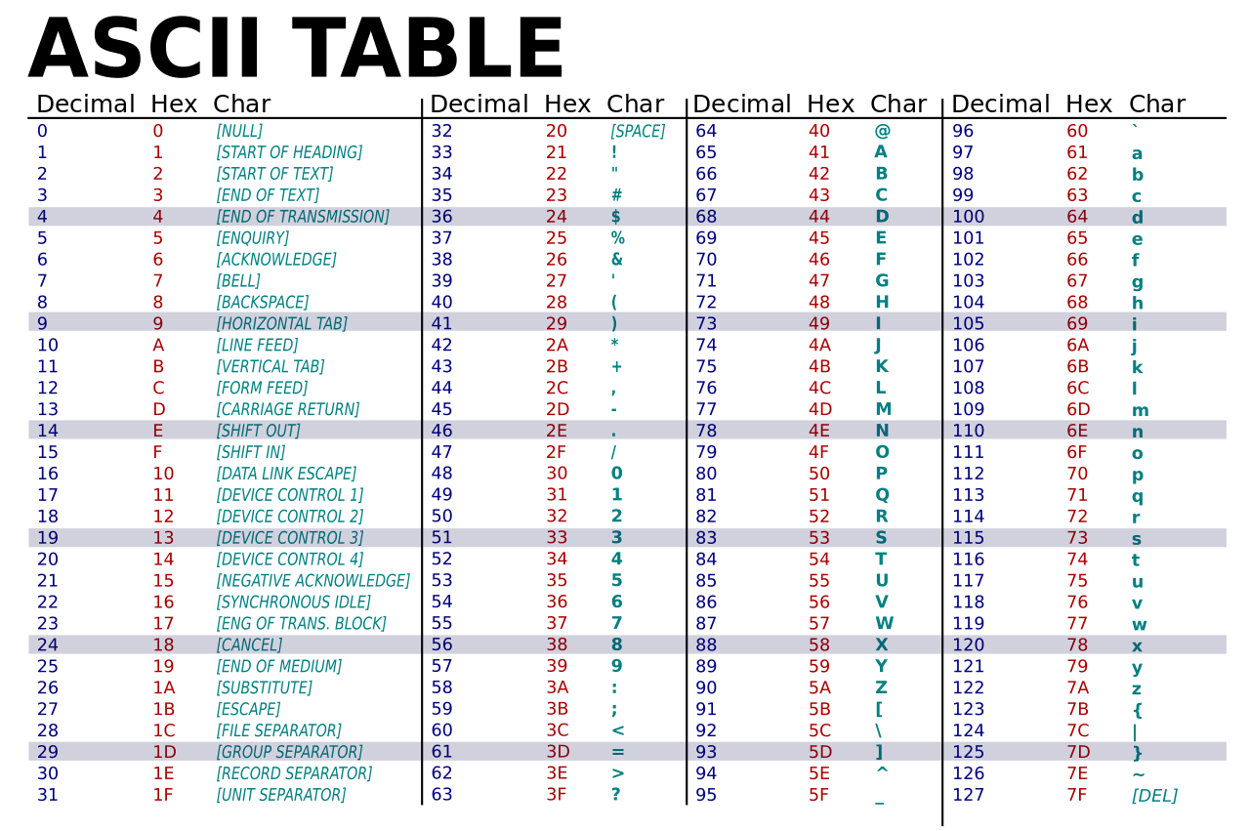
ASCII – DECIMAL – HEX - CHAR

Slide 35
Data Elements Format Interpretation
Abbreviation | Meaning
a | Alpha, including blanks
n | Numeric values only
s | Special characters only
an | Alphanumeric
as | Alpha & special characters only
ns | Numeric and special characters only
ans | Alphabetic, numeric and special characters.
b | Binary data
z | Tracks 2 and 3 code set as defined in ISO/IEC 7813 and ISO/IEC 4909 respectively
. or .. or ... | variable field length indicator, each . indicating a digit.
x or xx or xxx | fixed length of field or maximum length in the case of variable length fields.

Slide 36
Data Elements Format Interpretation
Type | Meaning
Fixed | no field length used
LLVAR or (..xx) | Where LL < 100, means two leading digits LL specify the field length of field VAR
LLLVAR or (...xxx) | Where LLL < 1000, means three leading digits LLL specify the field length of field VAR
LL and LLL are hex or ASCII. A VAR field can be compressed or ASCII depending of the data element type. | LL can be 1 or 2 bytes. For example, if compressed as one hex byte, '27x means there are 27 VAR bytes to follow. If ASCII, the two bytes '32x, '37x mean there are 27 bytes to follow. 3 digit field length LLL uses 2 bytes with a leading '0' nibble if compressed, or 3 bytes if ASCII. The format of a VAR data element depends on the data element type. If numeric it will be compressed, e.g. 87456 will be represented by 3 hex bytes '087456x. If ASCII then one byte for each digit or character is used, e.g. '38x, '37x, '34x, '35x, '36x.

Slide 37
ISO 8583 data elements
Data element | Type | Usage
1 | b 64 | Bit map (b 128 if secondary is present and b 192 if tertiary is present)
2 | n ..19 | Primary account number (PAN)
3 | n 6 | Processing code
4 | n 12 | Amount, transaction
5 | n 12 | Amount, settlement
6 | n 12 | Amount, cardholder billing
7 | n 10 | Transmission date & time
8 | n 8 | Amount, cardholder billing fee
9 | n 8 | Conversion rate, settlement
10 | n 8 | Conversion rate, cardholder billing
11 | n 6 | Systems trace audit number
12 | n 6 | Time, local transaction (hhmmss)
13 | n 4 | Date, local transaction (MMDD)
14 | n 4 | Date, expiration

Slide 38
ISO 8583 data elements
15 | n 4 | Date, settlement
16 | n 4 | Date, conversion
17 | n 4 | Date, capture
18 | n 4 | Merchant type
19 | n 3 | Acquiring institution country code
20 | n 3 | PAN extended, country code
21 | n 3 | Forwarding institution. country code
22 | n 3 | Point of service entry mode
23 | n 3 | Application PAN number
24 | n 3 | Function code (ISO 8583:1993)/Network International identifier (NII)
25 | n 2 | Point of service condition code
26 | n 2 | Point of service capture code
27 | n 1 | Authorizing identification response length
28 | n 8 | Amount, transaction fee
29 | n 8 | Amount, settlement fee
30 | n 8 | Amount, transaction processing fee

Slide 39
ISO 8583 data elements
31 | n 8 | Amount, settlement processing fee
32 | n ..11 | Acquiring institution identification code
33 | n ..11 | Forwarding institution identification code
34 | n ..28 | Primary account number, extended
35 | z ..37 | Track 2 data
36 | n ...104 | Track 3 data
37 | an 12 | Retrieval reference number
38 | an 6 | Authorization identification response
39 | an 2 | Response code
40 | an 3 | Service restriction code
41 | ans 16 | Card acceptor terminal identification
42 | ans 15 | Card acceptor identification code
43 | ans 40 | Card acceptor name/location
44 | an ..25 | Additional response data
45 | an ..76 | Track 1 data

Slide 40
ISO 8583 data elements
49 | an 3 | Currency code, transaction
50 | an 3 | Currency code, settlement
51 | an 3 | Currency code, cardholder billing
52 | b 64 | Personal identification number data
53 | n 18 | Security related control information
54 | an ...120 | Additional amounts
55 | ans ...999 | EMV data
56 | ans ...999 | Reserved ISO
60 | an .7 | Advice/reason code (private reserved)
61 | ans ...999 | Reserved private
62 | ans ...999 | Reserved private
63 | ans ...999 | Reserved private
64 | b 16 | Message authentication code (MAC)

Slide 41
Embossing
Plastic details setup
for the Account
All these activities
invoke Embossing ,
PIN Generation
Embossing
PIN Generation
Card Generation
and mailing
Renewal
Cards
Additional
Cards
Replacement
Cards
New Cards
Notes:
At the time of embossing, plastic details like the valid from, to dates etc. are stored. PIN numbers are generated for the embossed card. Both the PIN number and the plastic would be sent to the card member.
Embossing program is invoked during renewal, issuance of additional cards, replacement and new cards

Slide 42
Session 2
21st January
Basic introduction to EMV
DES cryptography and data dependencies
PIN based transaction and PIN translation
Notes:
A credit card imprinter is a non-electronic, manually operated machine that makes an imprint (hence the name) of the face of your credit card and transfers it onto a double receipt. Once an imprint of your credit card is successfully accomplished, you sign it, and the proprietor or shopkeeper rips the perforated edge, keeps the original (top) copy and gives you the imprinted (bottom) copy.

Slide 43

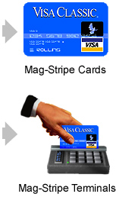
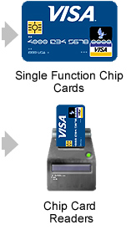
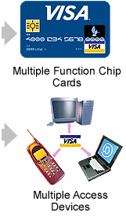
Cards and Devices to evolve
Notes:
A credit card imprinter is a non-electronic, manually operated machine that makes an imprint (hence the name) of the face of your credit card and transfers it onto a double receipt. Once an imprint of your credit card is successfully accomplished, you sign it, and the proprietor or shopkeeper rips the perforated edge, keeps the original (top) copy and gives you the imprinted (bottom) copy.

Slide 44
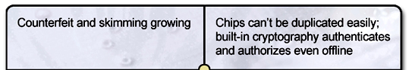
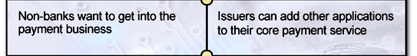
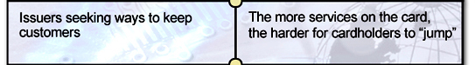
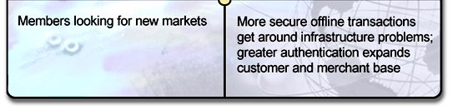
Why Chip?

Slide 45
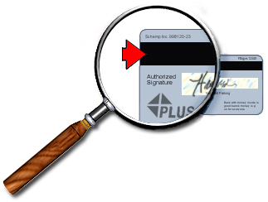

Can’t Magnetic Stripe Help?
Magnetic stripes on cards will be around for the foreseeable future (10+ years)
Visa will continue to seek security improvements in mag stripe
Card Verification Value, Address Verification Service strong tools to combat fraud
But rely on networks
Hi-coercivity cards
PIN added to debit or credit does give benefits
Also requires online infrastructure

Slide 46
Why Is Chip Better?
Smart cards provide effective security against fraud even offline
Smart cards are becoming the standard for non-payment in new devices
Access to set top boxes, PC readers and mobile phones
Chips hold 100+ times more information than stripes
Sophisticated security features
Multiple applications
Countries implementing chip may be exporting fraud to non-chip areas
An international standard (EMV) has been developed based on ISO7816

Slide 47
EMV Origination
EMV – Europay, MasterCard, Visa (now also JCB and Amex)
EMVCo (est. 1999) – entity established to manage the Specifications
Specifications started in 1996, but are only the base…
Now have Common Core Definition and Common Payment Application
Each Scheme has own application details
Visa = VIS = VSDC
MasterCard = M/Chip
Amex = AEIPS
JCB = J/Smart
EMVCo = CPA etc
Local
Settings
Int’l Card
Schemes
EMVCo

Slide 48
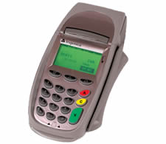
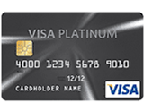
Coverage of the specifications
Data collection
Data authorisation
Local: Acquirer parameters
Transaction storage
Communications
protocol
Schemes: parameters
Auth format, specific
functions
Card bureau, Issuer,
Schemes
Transaction
Flow
Data
Interface
Interface
& Data
Risk management
Cryptography of txs
Personalisation
Not specified
By EMV
Not specified
By EMV
EMV Specifications

Slide 49
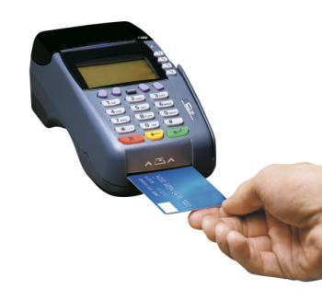
More on EMV…
For Global Interoperability
Payment application is resident in a secure chip
Secure Chip provides 4 key elements
Can store information
Can perform processing
Store secret information securely
Perform cryptographic processing

Slide 50
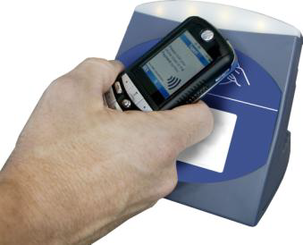
More on EMV…
To Execute a payment transaction
Chip must connect to a chip reader in an acceptance terminal
Physical Contact interface
Contactless interface
Sufficient proximity from the reader, 4 cm. max
Dual Interface – Contact + Contactless
Acceptance terminal provides power to the chip
To enable the chip to process, contact (or) contactless

Slide 51
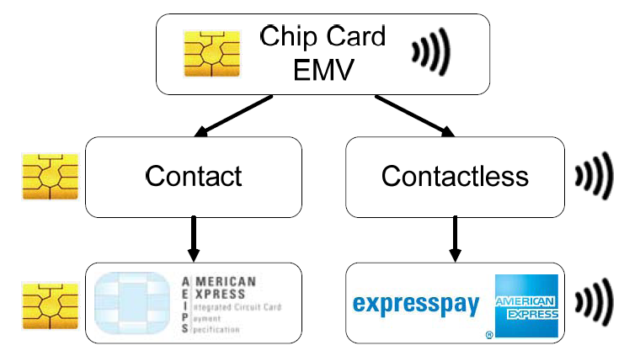
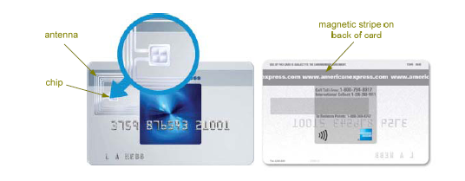
Chip card terminology Hierarchy

Slide 52
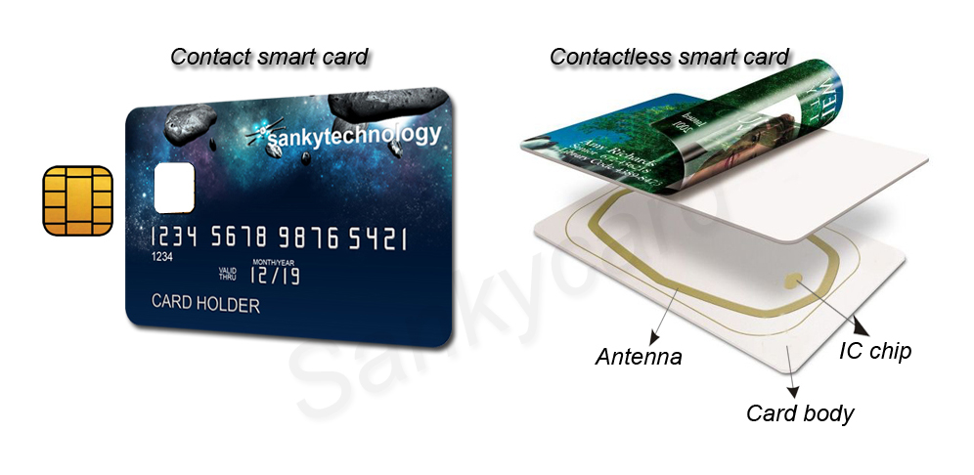
Anatomy of chip card

Slide 53
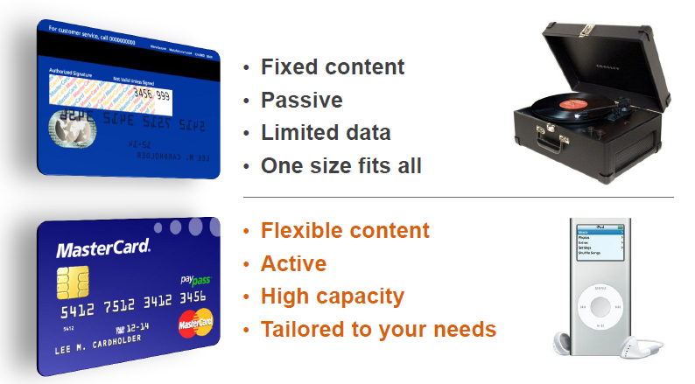
Mag stripe vs Chip

Slide 54
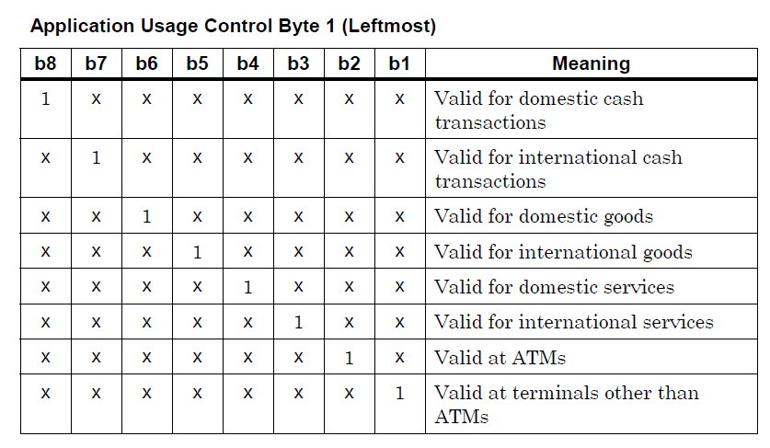
Security benefits of EMV
Cloning a circuit is not easy – Tamper resistance techniques
With online authorization, a dynamic cryptogram protects against the use of skimmed data and stolen account data
With offline authorization, a PIN capability protects against lost and stolen card fraud
With offline authorization, data authentication protects against counterfeit cards
Limits on offline activity protects against credit overruns and fraud
Card usage restrictions such as international use prohibitions are systematically enforced (Application Usage control)
Notes:
Random glue logic: randomizing the physical layout and adding extra circuits that don't contribute to the logic, to make reverse engineering the circuits harder.
Packaging made of chemical substances that cannot easily be peeled off, the idea being that stripping off the packaging is likely to damage the chip as well.
Self-tests in software that disable the card if something unexpected happens, which makes active attacks (that perturb the execution) harder to pull off.

Slide 55
Business and Operational benefits of EMV
Reduces fraud costs associated with counterfeit cards.
Facilitates the use of Offline transactions, which can lessen telecommunications costs and potentially speed transaction throughput.
Enables Cardholder Verification during the transaction with the introduction of Offline PIN capability.
Offline PIN:
Removes the requirement for Merchants to store physical signatures.
Reduces potential for lost and stolen card fraud.
Does not require the Acquirer to support the secure transmission of PIN data back to the Issuer.
Can further increase transaction throughput over written signature verification.
Also provides benefits for Merchants, including:
Reduced authorization expenses.
Reduced transaction disputes and chargebacks.
Increased fraud protection through the use Offline PIN at Unattended Payment Terminals (UPTs).
Notes:
Random glue logic: randomizing the physical layout and adding extra circuits that don't contribute to the logic, to make reverse engineering the circuits harder.
Packaging made of chemical substances that cannot easily be peeled off, the idea being that stripping off the packaging is likely to damage the chip as well.
Self-tests in software that disable the card if something unexpected happens, which makes active attacks (that perturb the execution) harder to pull off.

Slide 56
EMV Reduces Fraud in Card Present Scenarios
Offline Card Authentication
Static Data Authentication (SDA)
Dynamic Data Authentication (DDA)
Combined Data Authentication (CDA)
Online Card Authentication
Cryptogram Validation
(ARQC)
Supported CVM’s
Offline PIN
Signature
No cardholder verification method
(CVM)
Authorization
Rules
Online
Offline
Online PIN
BOTH CARD & TERMINAL capabilities impact authorization, authentication & CVM’s used for any given transaction
Offline data authentication may still happen even though a transaction is ultimately sent online for approval
Notes:
Random glue logic: randomizing the physical layout and adding extra circuits that don't contribute to the logic, to make reverse engineering the circuits harder.
Packaging made of chemical substances that cannot easily be peeled off, the idea being that stripping off the packaging is likely to damage the chip as well.
Self-tests in software that disable the card if something unexpected happens, which makes active attacks (that perturb the execution) harder to pull off.

Slide 57
EMV Environment
Mag-stripe Card
CAD / Terminal
Acquirer
Issuer
EMV Card
CAD / Terminal
Network
(Visa, MasterCard, Amex, JCB, etc)
VIS
M/Chip
EMV CPA
EMV 4.3
EMV 4.3
Visa
MasterCard
ISO8583
AS2805
ISO8583
Visa Base I/II
AS2805
TC Upload (0320)

Slide 58
Fallback Transactions
Technical fall forwards
Contactless Chip → Contact Chip
Technical Fallback
Chip → Magnetic Stripe → Manual Entry
Electronic Fallback
Offline Transactions
Issuer/host unavailable →Default Processing (Offline)
CVM Fallback
PIN bypassed, Signature required (Issuer requirement)
No CVM to Signature (Acquirer specific requirement)

Slide 59
Technical Fallbacks
EMV Card
CAD / Terminal
Acquirer
Issuer
Network
(Visa, MasterCard, Amex ,JCB, etc)
Track 2 Data from magnetic stripe
Magnetic Stripe Transaction
POS Entry Mode (Track 2 from magnetic stripe), Terminal Capability Code (Chip capable terminal)

Slide 60
Electronic fallbacks
EMV Card
CAD / Terminal
Acquirer
Issuer
Network
(Visa, MasterCard, Amex, JCB, etc)
1
2
3
Stand-in /
Default
Processing
1
Full EMV
Stand-in /
Default Processing (RC 91)
2
Full EMV
3
Full EMV
Stand-in /
Default Processing (RC 91)

Slide 61
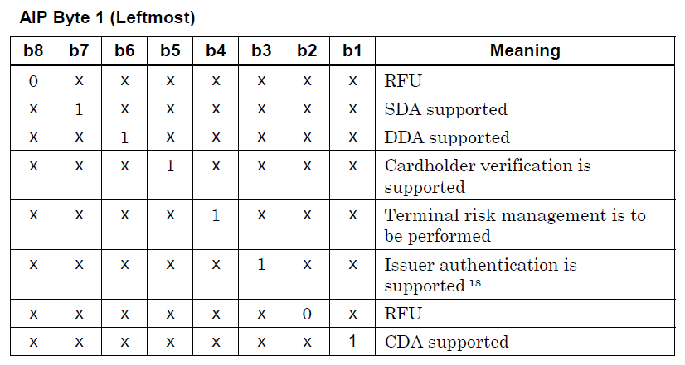
The CHIP Profile
EMV allows offline transactions
That is:
An offline CAM – SDA, DDA OR CDA
An offline CVM – Online PIN(ATM), Offline PIN, Online PIN, Signature, No CVM
An offline Authorization

Slide 62
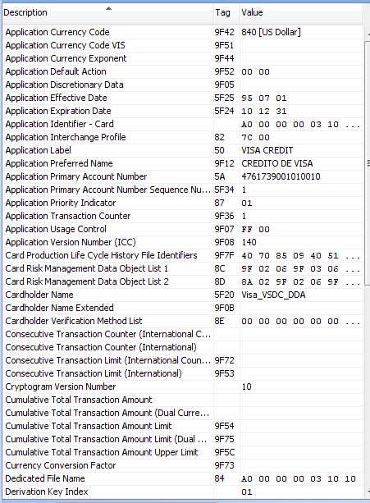
EMV data on the CHIP

Slide 63
ISO8583 – DE 55 –Chip data
F 55 Integrated Circuit Card (ICC) Data ( 83) = (x) 5f2a02082682025800950500000080009a031205149c01019f02060000000010009f100908f01003a00000dac19f1a0208409f2608adca9febe83e57d89f2701809f34034103029f360200039f37042516d540
SF 2 Tag 5f2a Transaction Currency Code ( 2) = (x) 0826
SF 6 Tag 82 Application Interchange Profile ( 2) = (x) 5800
SF 9 Tag 95 Terminal Verification Results ( 5) = (x) 0000008000
SF 10 Tag 9a Terminal Transaction Date ( 3) = (x) 120514
SF 11 Tag 9c Cryptogram Transaction Type ( 1) = (x) 01
SF 12 Tag 9f02 Cryptogram Amount ( 6) = (x) 000000001000
SF 20 Tag 9f10 Issuer Application Data ( 9) = (x) 08f01003a00000dac1
SF 21 Tag 9f1a Terminal Country Code ( 2) = (x) 0840
SF 23 Tag 9f26 Cryptogram ( 8) = (x) adca9febe83e57d8
SF 24 Tag 9f27 Cryptogram Information Data ( 1) = (x) 80
SF 26 Tag 9f34 CVM Results ( 3) = (x) 410302
SF 28 Tag 9f36 Application Transaction Counter ( 2) = (x) 0003
SF 29 Tag 9f37 Unpredictable Number ( 4) = (x) 2516d540

Slide 64
EMV Commands
ISO/IEC 7816-3 defines the transmission protocol between chip cards and readers. Using this protocol, data is exchanged in application protocol data units (APDUs). This comprises sending a command to a card, the card processing it, and sending a response. EMV uses the following commands:
application block
application unblock
card block
external authenticate (7816-4)
generate application cryptogram
get data (7816-4)
get processing options
internal authenticate (7816-4)
PIN change / unblock
read record (7816-4)
select (7816-4)
verify (7816-4)

Slide 65
Registered EMV Apps with ISO 7816-5 RA
Card scheme | RID | Product | PIX | AID
Visa | A000000003 | Visa credit or debit | 1010 | A0000000031010
 |  | Visa Electron | 2010 | A0000000032010
 |  | V PAY | 2020 | A0000000032020
 |  | Plus | 8010 | A0000000038010
MasterCard | A000000004 | MasterCard credit or debit | 1010 | A0000000041010
 |  | MasterCard | 9999 | A0000000049999
 |  | Maestro (debit card) | 3060 | A0000000043060
 |  | Cirrus (interbank network) | 6000 | A0000000046000
UK Domestic Maestro - Switch (debit card) | A000000005 | Maestro UK | 0001 | A0000000050001
 |  | Solo | 0002 | A0000000050002
American Express | A000000025 | American Express | 01 | A00000002501
RuPay (India) | A000000524 | RuPay | 1010 | A0000005241010
Discover | A000000152 | Discover | 3010 | A0000001523010
Interac (Canada) | A000000277 | Debit card | 1010 | A0000002771010
JCB | A000000065 | Japan Credit Bureau | 10 | A00000006510
LINK (UK) ATM network | A000000029 | ATM card | 1010 | A0000000291010
Dankort (Denmark) | A000000121 | Debit card | 1010 | A0000001211010
CoGeBan(Italy) | A000000141 | PagoBANCOMAT | 0001 | A0000001410001
Banrisul (Brazil) | A000000154 | Banricompras Debito | 4442 | A0000001544442
ZKA (Germany) | A000000359 | Girocard | 1010028001 | A0000003591010028001
CB card (France) | A000000042 | CB card | 1010 | A0000000421010
SPAN2 (Saudi Arabia) | A000000228 | SPAN | 1010 | A0000002282010/1010

Slide 66
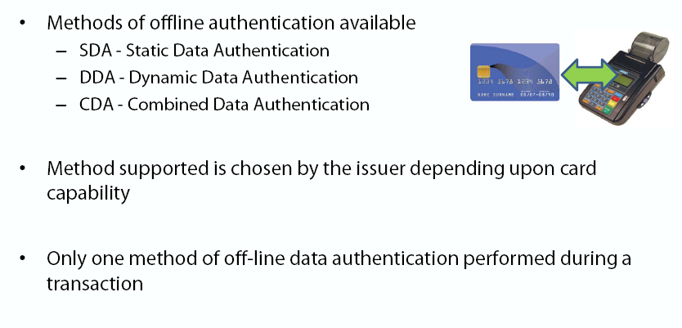
Offline Data Authentication

Slide 67
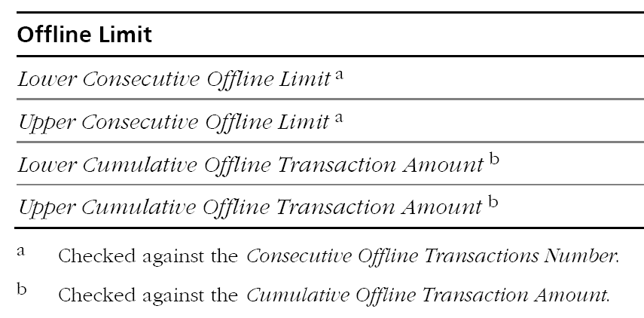
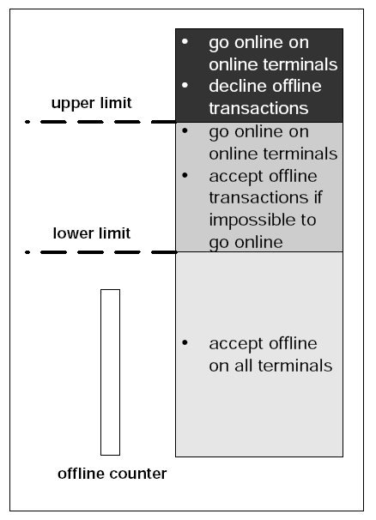
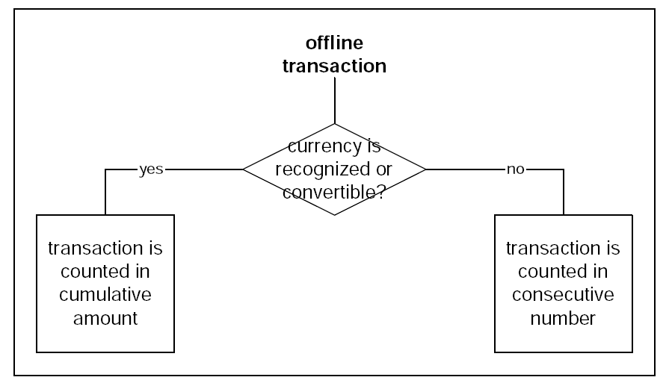
Offline Counters and Limits
Counters
Cumulative Offline Transaction Amount → Consecutive Offline Transactions Number

Slide 68
EMV Transaction flow
An EMV transaction has the following steps:
Application selection
Initiate application processing
get processing options with processing options data objects list (PDOL)
ICC provides - AIP, AFL
Read application data (record – AFL read) using read command, C(ard)DOL1
Processing restrictions (Application checks – version, AUC and expiry, update TVR)
Offline data authentication (based on AIP)
Cardholder verification (CVM check to be performed)
Terminal risk management (Limit checks – Online or Offline – update TVR)
Terminal action analysis (Terminal informs ICC)
First card action analysis (CDOL1 complete and passed to ICC)
Transaction certificate (TC)—Offline approval
Authorization Request Cryptogram (ARQC)—Online authorization
Application Authentication Cryptogram (AAC)—Offline decline
Online transaction authorization (only carried out if required by the result of the previous steps; mandatory in ATMs) – ARQC and ARPC
Second card action analysis – CDOL2 passed to ICC
Issuer script processing

Slide 69
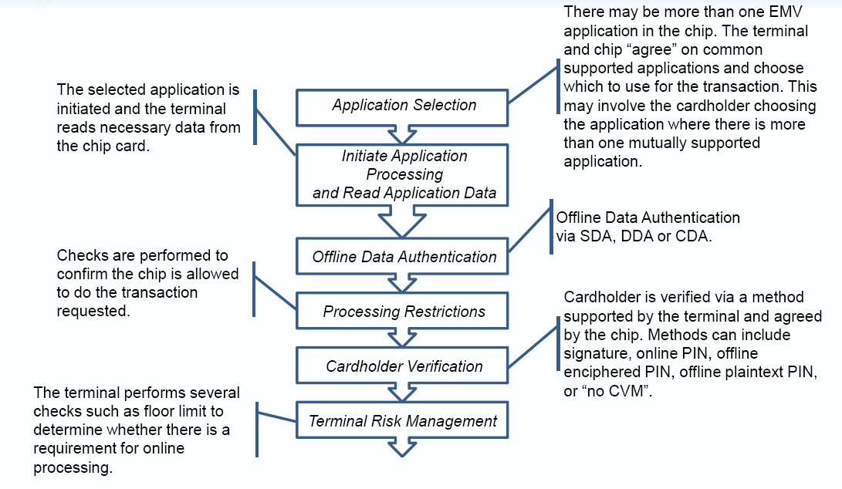
EMV Transaction flow contd…

Slide 70
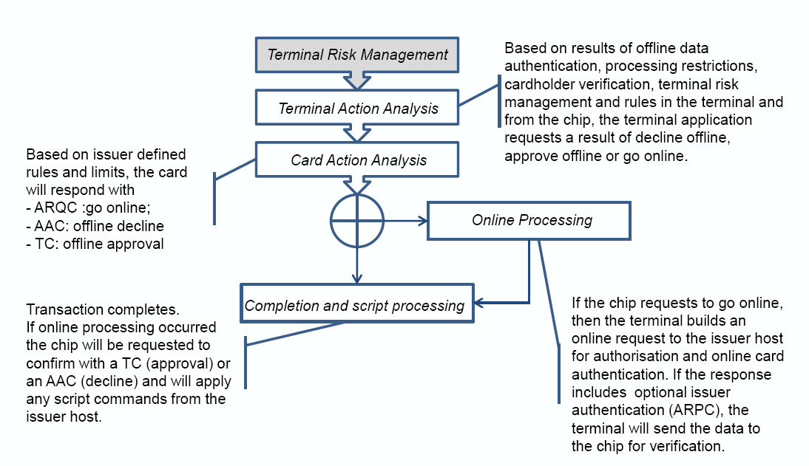
EMV Transaction flow contd…

Slide 71
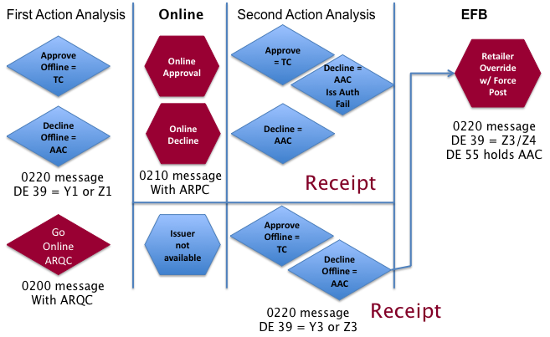
EMV Transaction Decisions at a glance …
0120/
0110/
0120/
0100/
0120/

Slide 72
Usage of DES in Financial messages
Important
CVV/CVC key - To generate CVV, iCVV, dCVV, CVV2 - Visa
CVC, iCVC, CVC3, CVC2 - Mastercard
CSC Key - To generate 5CSC, iCSC, iCSC(2), 4DBC, 3SC - Amex
PIN Work Key - To encrypt clear PIN into 8 byte enciphered block
Pin Key - To calculate PVV for Track 2 using Clear PIN
MDK - To generate the ARQC – Signing the transaction data
To validate ARPC
AMEX Cryptogram version 2
MAC Key - To generate unique Message Authentication Code

Slide 73
Authorization Txn differentiation
Important
Transaction Type | DE 22 |  |  | Other Data
 | MC | VISA | AMEX
Contactless EMV | 07 | 07 | 5****X5***** | DE 55, Track 2 with iCVV/iCVC/iCSC
Contactless mag stripe | 91 | 91 | 2****X2***** | Track 2 with dCVV/CVC3/Crypt Ver 2
EMV Insert | 05 | 05 | 5****15***** | DE 55, Track 2 with iCVV/iCVC/iCSC
Mag Stripe | 90 | 90 | 2****12***** | Track 2 with CVV/CVC/5CSC
Mag Stripe Fallback | 80 | 90 | 2****19***** | Track 2 with CVV/CVC/5CSC
Manual | 01 | 01 | 2****11***** | CVV2/CVC2/3CSC or 4 DBC

Slide 74
© SQS Software Quality Systems

